Slide 1

Allocate Books to Students
This presentation outlines an efficient approach to solve the problem of allocating books to students, ensuring each student gets contiguous books and minimizing the maximum number of pages assigned to any student. We will explore the problem statement, solution steps, code implementation, complexity analysis, and edge cases.

Slide 2
Understanding the Problem
Example 1
Example 2
Given arr = [12, 34, 67, 90] and k = 2, the output is 113. Possible allocations include [12] & [34, 67, 90] (max pages = 191), [12, 34] & [67, 90] (max pages = 157), and [12, 34, 67] & [90] (max pages = 113). The minimum of these cases is 113.
Given arr = [15, 17, 20] and k = 5, the output is -1. Since there are only 3 books and 5 students, allocation is impossible.

Slide 3
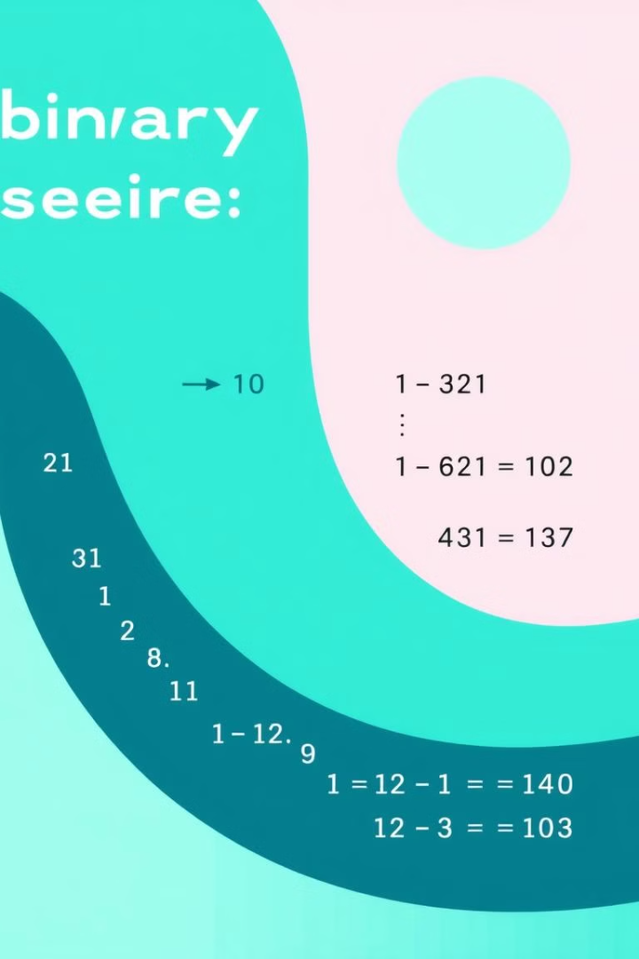
Defining the Search Space
To efficiently find the minimum max pages, we define a search space. The minimum max pages assigned to any student must be at least the largest book (max(arr)). The maximum max pages is the sum of all books (sum(arr)). We perform a binary search within this range to find the optimal solution.
For example, with arr = [12, 34, 67, 90] and k = 2, the search space is between max(arr) = 90 and sum(arr) = 203.

Slide 4

Binary Search Function
We use binary search on the possible values of maxPages to find the optimal allocation. The findMinimumPages function in Java efficiently searches for the minimum possible value of maxPages that satisfies the allocation conditions.
public static int findMinimumPages(int[] arr, int k) {
int n = arr.length;
if (k > n) return -1;
int start = Integer.MIN_VALUE, end = 0, result = 0;
for (int pages : arr) {
start = Math.max(start, pages);
end += pages;
}
while (start <= end) {
int mid = (start + end) / 2;
if (isPossible(arr, n, k, mid)) {
result = mid;
end = mid - 1;
} else {
start = mid + 1;
}
}
return result;
}

Slide 5

Feasibility Function
1
Checking Allocation
2
Student Count
3
Return Value
The isPossible() function checks whether a given max page allocation is feasible. It simulates the allocation process to determine if the books can be allocated to k students without exceeding maxPages.
It iterates through the books, assigning them to students while tracking the current sum of pages. If adding a book exceeds maxPages, a new student is allocated.
If the number of students needed exceeds k, the function returns false, indicating that the allocation is not possible. Otherwise, it returns true.

Slide 6

Executing the Code
To validate the solution, the code is executed with example inputs. The main function in Java demonstrates the usage of the findMinimumPages function with different arrays and student counts, showcasing the expected outputs.
public static void main(String[] args) {
int[] arr1 = {12, 34, 67, 90};
int k1 = 2;
System.out.println(findMinimumPages(arr1, k1)); // Output: 113
int[] arr2 = {15, 17, 20};
int k2 = 5;
System.out.println(findMinimumPages(arr2, k2)); // Output: -1
int[] arr3 = {22, 23, 67};
int k3 = 1;
System.out.println(findMinimumPages(arr3, k3)); // Output: 112
}

Slide 7
Complexity Analysis
Time Complexity
Space Complexity
The time complexity of the solution is O(n log(∑(arr))), where n is the number of books. This is due to the binary search, which has a complexity of O(log(∑(arr) - max(arr))), and the feasibility check, which has a complexity of O(n).
The space complexity is O(1), as the solution uses only a few extra variables and does not depend on the input size.

Slide 8
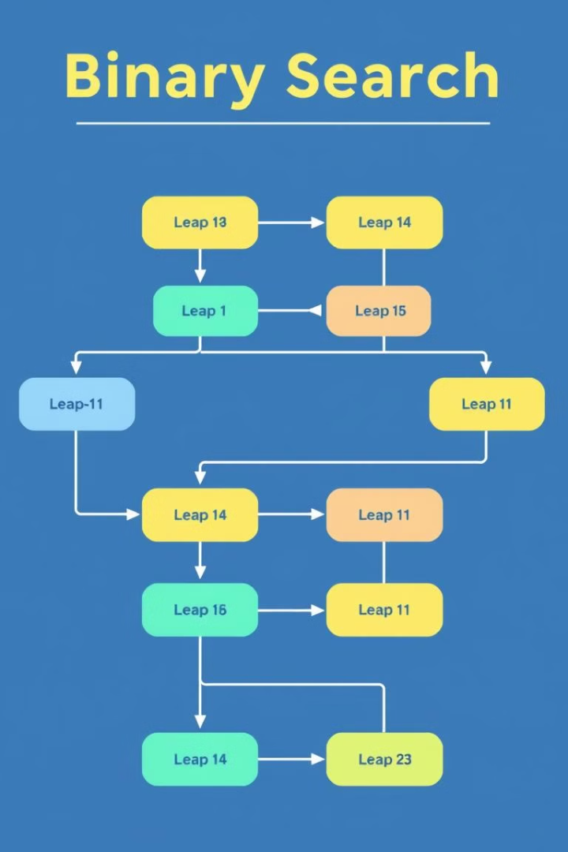
Dry Run Example
A dry run for arr = [12, 34, 67, 90] and k = 2 illustrates the step-by-step execution of the binary search algorithm. The search space is initialized to [90, 203], and the algorithm iteratively narrows down the range until the optimal value of 113 is found.
Each step involves checking the feasibility of the current maxPages value and updating the search space accordingly. The algorithm terminates when the stop condition is met, providing the final answer.

Slide 9

Edge Cases
More Students Than Books
Only One Student
If there is only one student (k=1), the function should return the sum of all pages in the books.
If the number of students (k) is greater than the number of books, it is impossible to allocate books, and the function should return -1.
Large Book Values
If each book has a large number of pages, ensure that the integer data type does not overflow during sum calculations.

Slide 10




Optimization and Handling
Use Long for Sum
Math Functions
Corner Cases
In C++, use long for sum calculations to prevent overflow when dealing with large page numbers.
Use Math.max() and Math.min() carefully in Java to ensure correct comparisons and assignments.
Handle corner cases like k > n to ensure the function returns the correct output.

